Slide 1


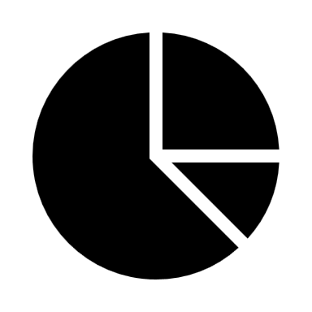
Time tracking/scheduling for working, studying and freetime projects
Episode 1
Simple start

Slide 2



Why do time tracking?
Delimit working time and free time and minimise procrastination
Keep an overview of how much you work/ in which project
Motivate yourself/ set goals

Slide 3

Idea:
Project 1
Overview table
different tables for each project
summarised in an overview table
create various informative graphs
Project 2
Project 3

Slide 4
Time tracking/scheduling for working, studying and freetime projects
Episode 2
The Overview Table

Slide 5
Idea:
Project 1
Overview table
different tables for each project
summarised in an overview table
create various informative graphs
Project 2
Project 3

Slide 6
Time tracking/scheduling for working, studying and freetime projects
Episode 3
The Weekly Overview Table

Slide 7

Idea:
Project 1
Overview table
Summarise working hours per week
Better overview for leisure/hobby objects
Also conceivable as a monthly overview
Project 2
Project 3

Slide 8
Improvement:
Using the combination:
FILTER(): Get values from specific week
SUM(): Summarize values
=SUM(FILTER(Worktime;Week;0))

